Slide 1
Arms Roped Challenge

Slide 2
Project Group # 4
1. Ashwanth Boinpally 11702455
2. Madhavi Neerati 11702641
3. Sai Vikram Yelamanchi. 11603289
4. Sathvik Reddy Nandyala 11702270

Slide 3
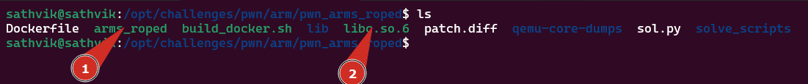
Overview
The ARMS ROPPED challenge is a binary exploitation challenge that involves bypassing the stack canary, address randomization (ASLR), and non-executable stack to achieve code execution by utilizing the Return-Oriented Programming (ROP) technique. The challenge file includes two core files and Docker setup files. The two files are:
The ARM binary program
The glibc shared library

Slide 4
Steps
Perform Preliminary checks
Static analysis in Ghidra
Dynamic analysis in gdb
Leak canary & elf base
Leak and calculate libc address
Get rop gadgets and construct a rop chain
Pop a shell

Slide 5

Perform Preliminary checks

Slide 6
Checks
To understand more about the binary's architecture and other specifics, we use the file command. Additionally, we utilize checksec to thoroughly examine the security permissions and configurations set on these files, which is crucial for preparing our approach to the challenge.

Slide 7
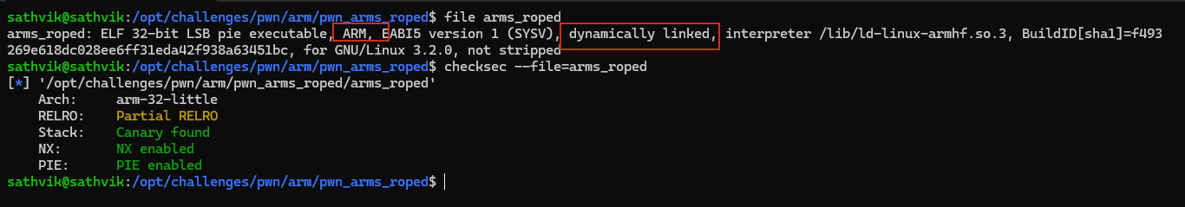
Checks
The arms_roped file is a 32-bit ELF executable for ARM, dynamically linked. It's compatible with GNU/Linux 3.2.0 and includes its debugging symbols as it's not stripped. Here are the key security features identified: 1. Partial RELRO: Offers limited protection against buffer overflow exploits.
2. Stack Canary: Helps protect against stack buffer overflows.
3. NX Enabled: Prevents execution of arbitrary code on stack and other non-executable regions.
4. PIE Enabled: Allows the binary to be loaded at random memory addresses, enhancing security against attacks that rely on fixed addresses.

Slide 8
Static analysis in Ghidra

Slide 9
Description
After completing the preliminary checks, we use Ghidra to decompile the binary. This process translates the binary back into a form that closely resembles the original source code, allowing us to better understand its functionality.

Slide 10
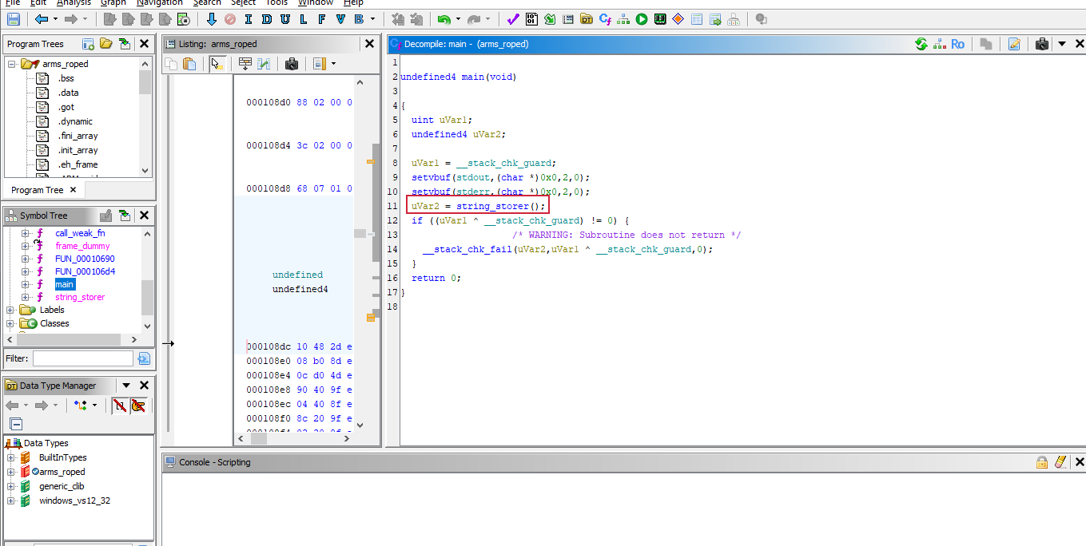
Main Function
The binary has a main function that calls another functions called string_storer

Slide 11
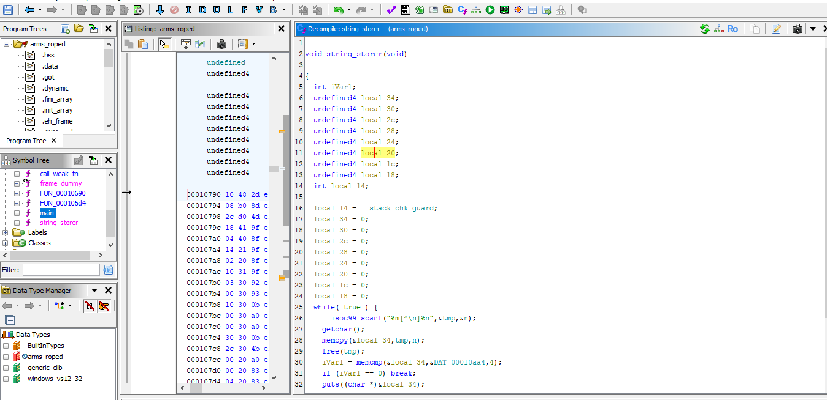
String storer
The string storer function takes in an input and just prints it back to stdout but we have to do a little cleaning so we can make better sense of the code.

Slide 12
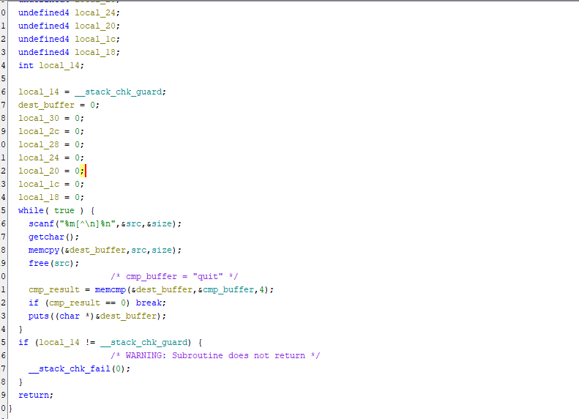
Cleaning in Ghidra
To clean up the function we try to give the functions intuitive names and also try to trace any global variables values but there is just so much you can achieve in ghidra so we copy the code and continue the cleanup in vscode

Slide 13
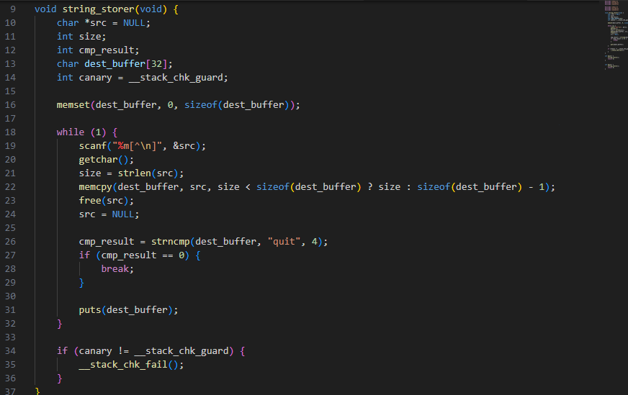
In Vscode 1
Note the line numbers as we will be using them in the explanation

Slide 14
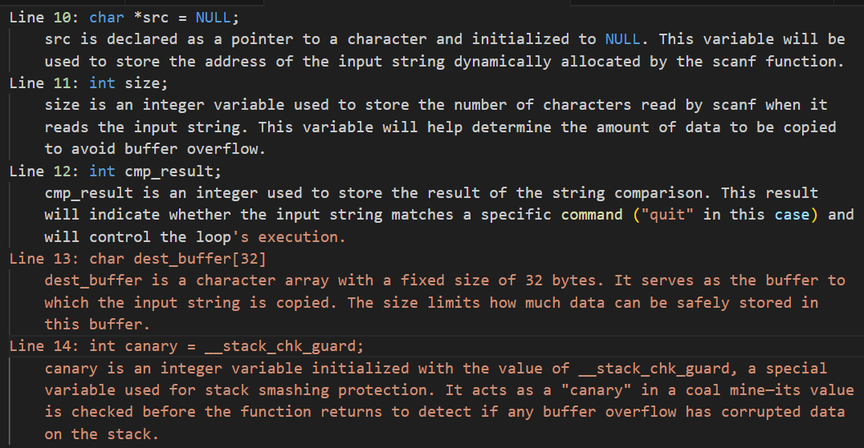
Code LinE 9 - 15

Slide 15
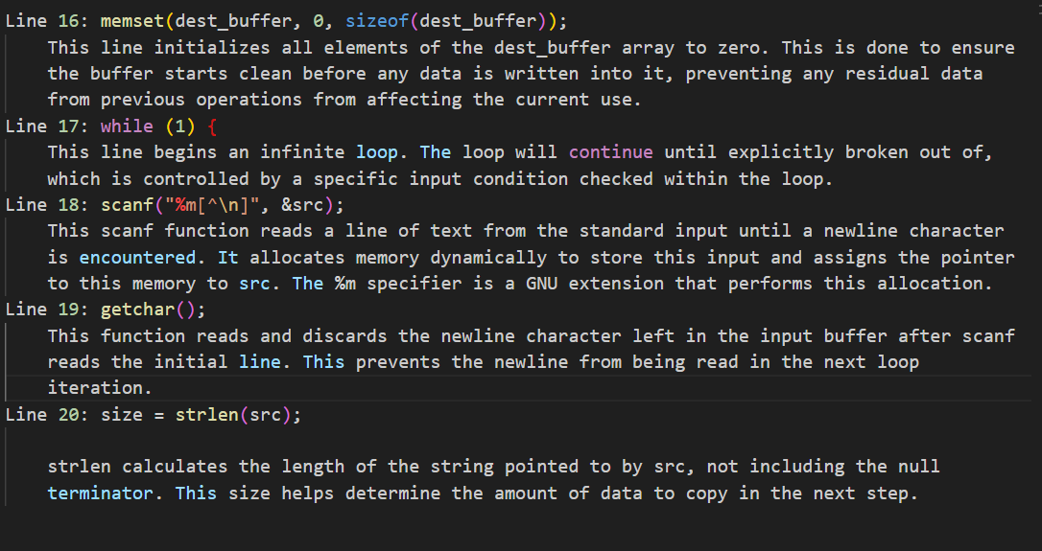
Code LinE 16 - 20

Slide 16
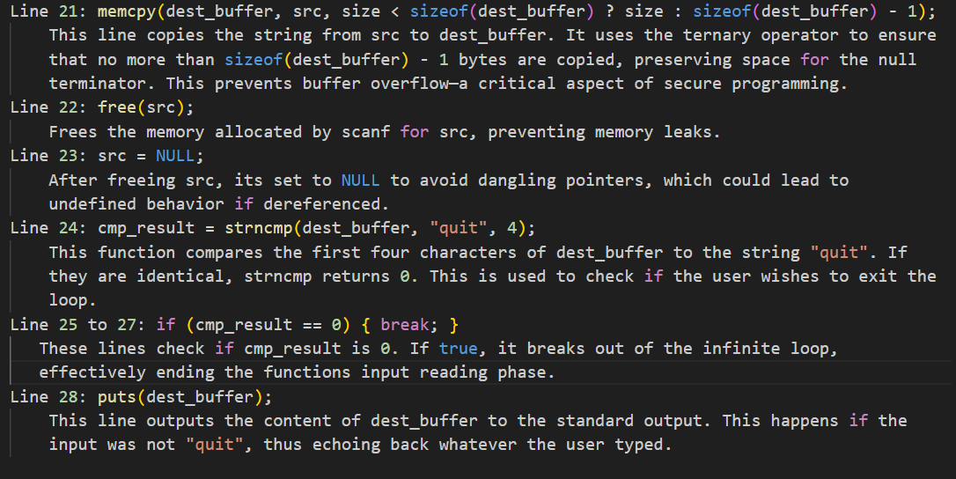
Code LinE 21 - 28

Slide 17
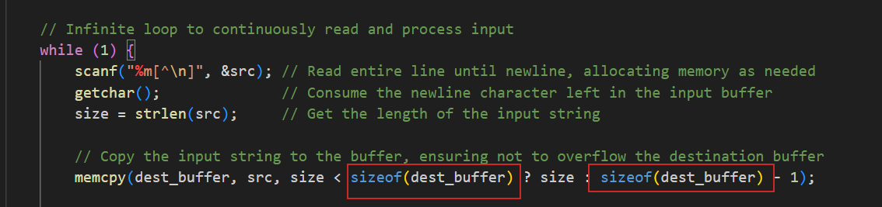
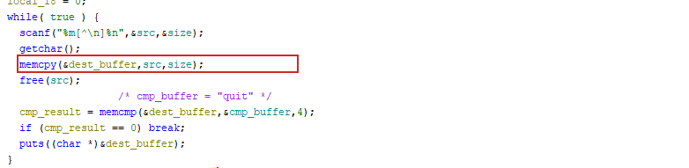
Something off
If you noticed, the code we refined has one significant difference from the original code. That's because the explained code actually patches the overflow vulnerability. Below, an image shows the difference.
In the code below, user input is copied to the buffer without any bounds checking, which allows us to perform a buffer overflow. However, we need to determine what specifically to overflow.

Slide 18
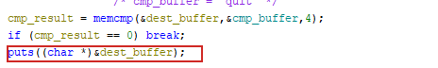
More things OFF
Having seen that we have a buffer overflow we notice that the programs uses “Puts” to print to stdout
The reason this is interesting is because puts will continue printing until it encounters a null byte. If we overflow the buffer, puts will continue printing memory contents until a null byte is reached. This behavior can be utilized to leak sensitive information such as the stack canary and libc addresses.

Slide 19
Dynamic analysis in gdb

Slide 20

Analysis
Now that we know what the program does and what exactly is wrong with it we can proceed to investigate this in gdb
To analyse the arm binary in gdb we make use of qemu and gdb-multiarch.

Slide 21
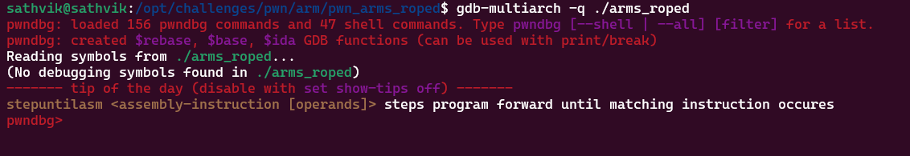
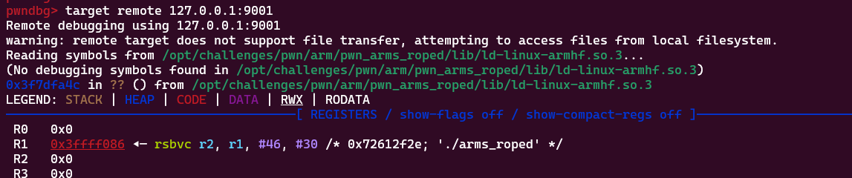
Attaching to gdb
First we run gdb-multiarch and set the library path
Then we start qemu and bind to a port and connect to it in gdb

Slide 22
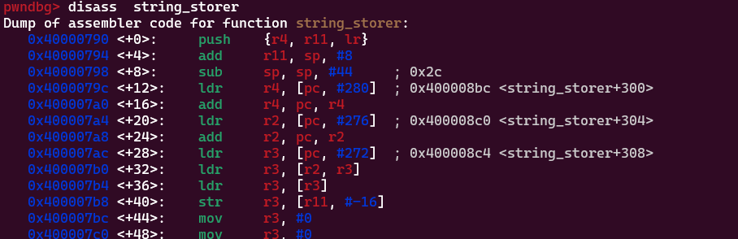
Analysis
Knowing that the program is 32-bit and vulnerable to a buffer overflow, and that it employs a stack canary which ends with a null byte, we can exploit this setup. By providing the program with exactly 8 bytes, we can carefully analyze the stack layout. This allows us to calculate the offset to the canary, positioning us to strategically manipulate the buffer overflow to our advantage.ary
First, we need to set a breakpoint immediately after the memcpy operation in the string_storer function. We begin by disassembling the string_storer function to identify the exact point where memcpy completes, enabling us to inspect the state of the stack at that critical moment.

Slide 23
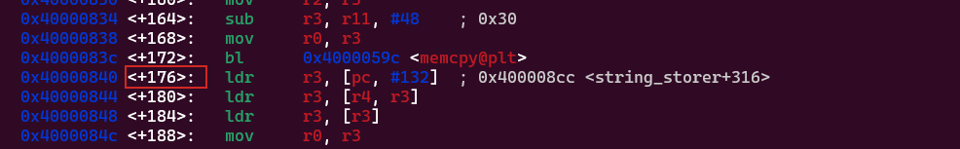
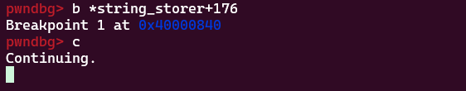
Break point
Scrolling through the disassembly, We find the offset of the memcpy instruction from the start of the string_storer function. With this information, We proceed to set the breakpoint at that specific offset. Once the breakpoint is set, We continue the execution of the program to observe and analyze the effects at the moment of the buffer overflow.
then In the tab with gemu We input some data and hit enter

Slide 24
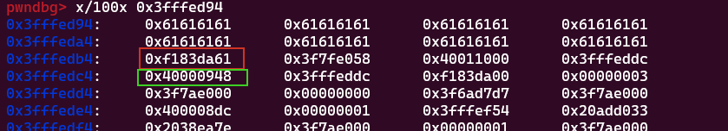
Investigating the Stack
After hitting the breakpoint we proceed to investigate the stack from where our input starts
In the screenshot, the canary is highlighted in red, and the return address is in green. The green section is crucial as it helps us calculate the base address. Additionally, observing the last address in the image, which appears twice, suggests that it might be the libc base address. Let’s investigate these assumptions further by examining these memory addresses and their correlations to confirm these.

Slide 25
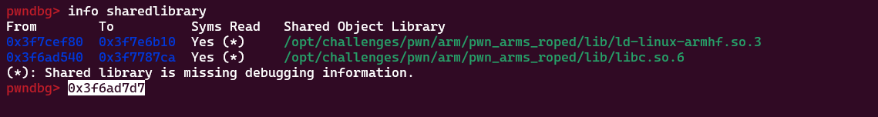
Verifying
Checking for shared libraries we see that the address we had seen on the stack falls in the range shown
For verifying canary we supply enough data to overwrite it. If we get a stack smash then its verified. The data has to start with quit.

Slide 26
Leak canary & elf base
We utilize pwntools to automate the process of leaking the addresses

Slide 27
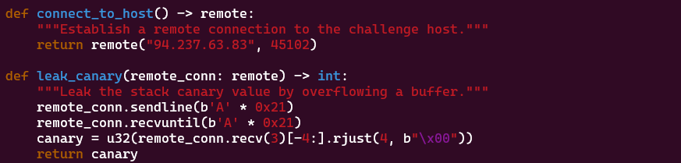
PwNtool - Canary
In the code below we send 33 bytes and then receive the same size.
Then we receive 3 more bytes as the last byte of a canary is always a null byte

Slide 28
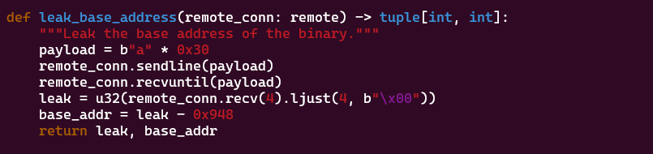
PwNtool – base Address
In the code below we send 48 bytes and receive the same amount.
Then we receive another 4bytes which is the elf base

Slide 29
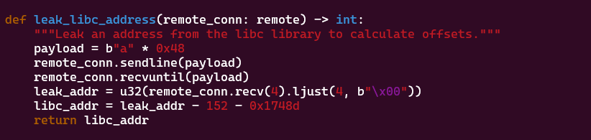
PwNtool – libc Address
In the code below we send 72 bytes and receive the same amount then receive the next 4 bytes. Given that the provided libc was different from the remote we had to calculate the base by subtracting the libc_start_main address and then making sure the address ends in 000 so we subtract 152.

Slide 30
Get rop gadgets and construct a rop chain
We utilize ropper to get the ropchains and address of “/bin/sh” string

Slide 31
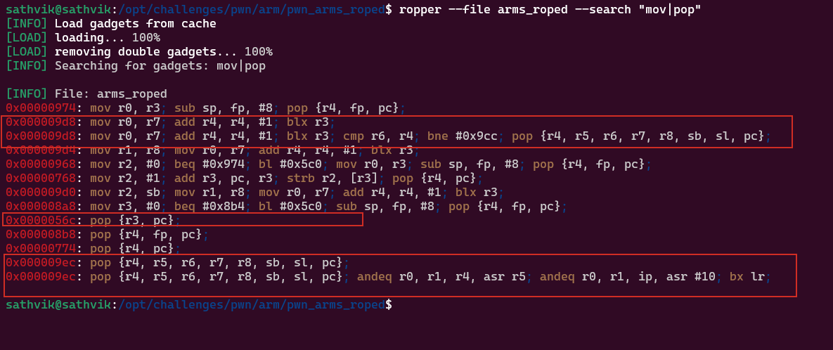
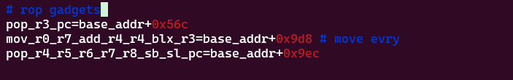
ropper– get mov and pop gadgets
We utilize ropper to search for interesting gadgets

Slide 32
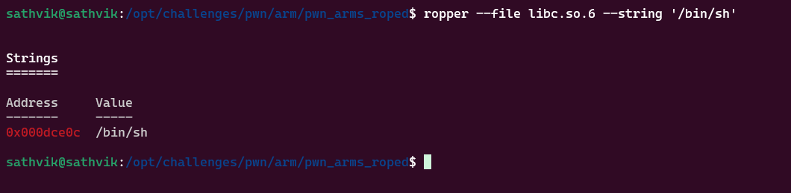
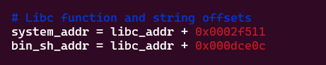
ropper– get /bin/sh string
We utilize ropper to search for /bin/sh string in the shared library and also use objdump to get address offset of system

Slide 33
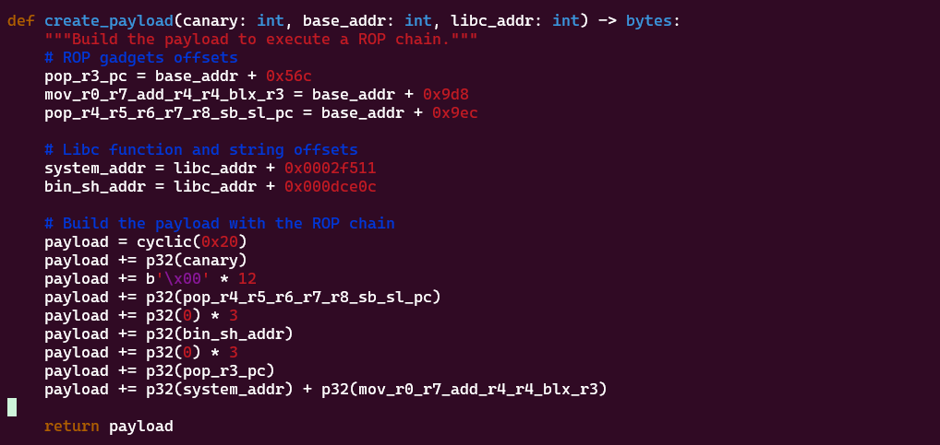
The Payload
The code below shows the payload creation … we assemble our ropchain by placing the /bin/sh string onto the stack and calling system with it as the argument.

Slide 34
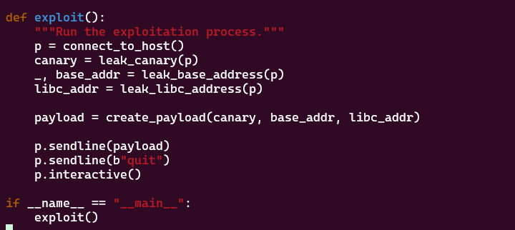
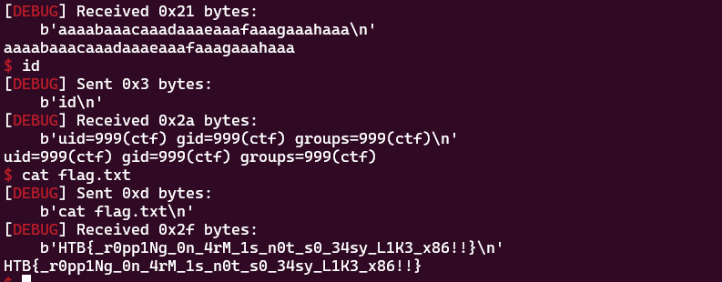
Pop a Shell
We execute the script against the remote system and gain a shell

Slide 35
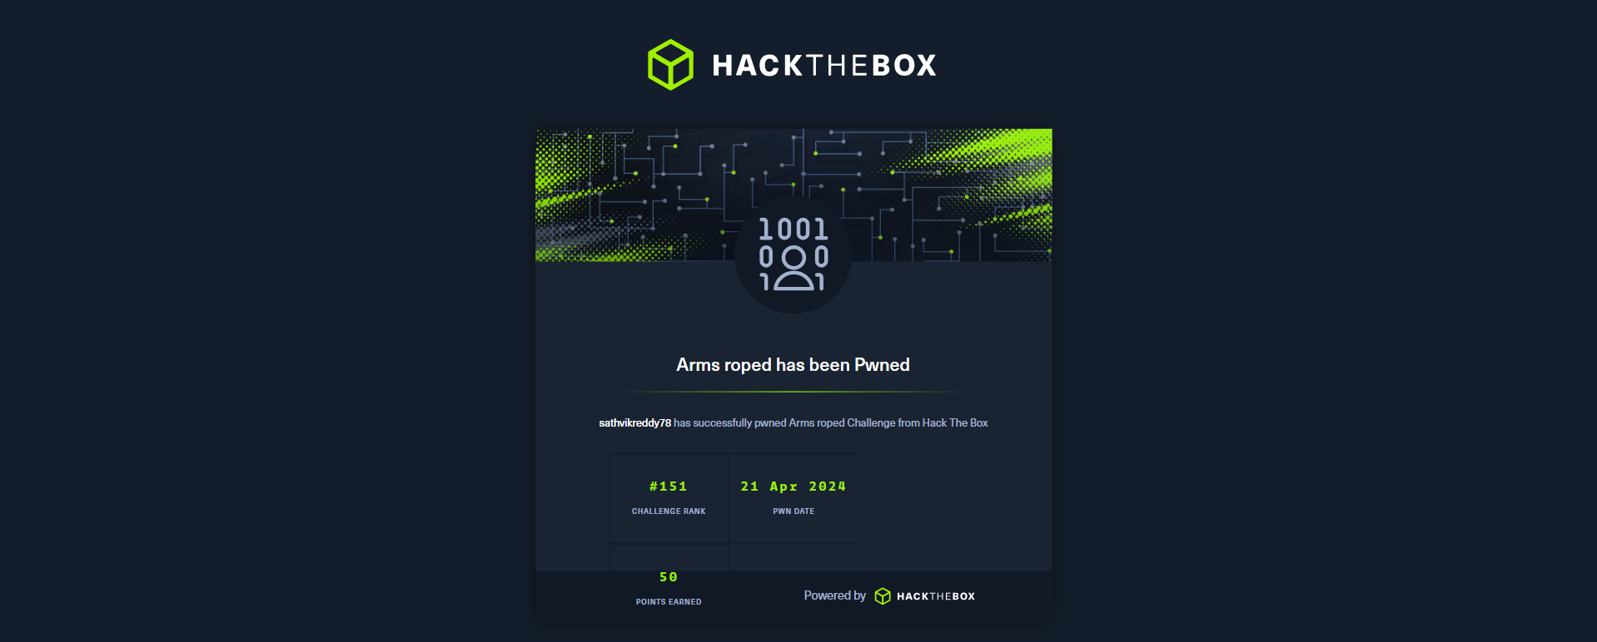
BOX SOLVED

Slide 36
THANK YOU

